Slide 1
MDF-Net: Multimodal Dual-Fusion Network for Abnormality Detection using CXR Images and Clinical Data

Slide 2
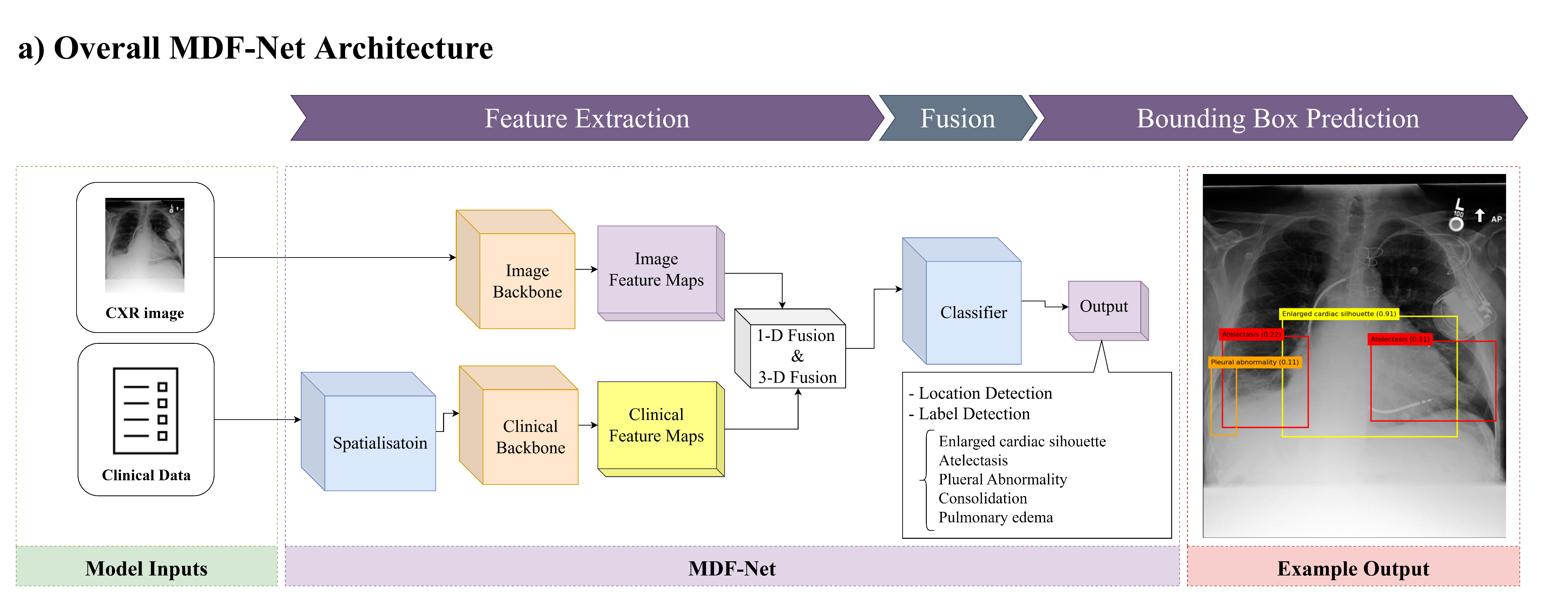
What is this work about?
This work aims to improve the explainability of the model by introducing clinical data into the abnormality detection task.
We proposed a new model architecture inspired by Mask R-CNN that allows the model to perform multimodal learning with clinical data and CXR images.

Slide 3
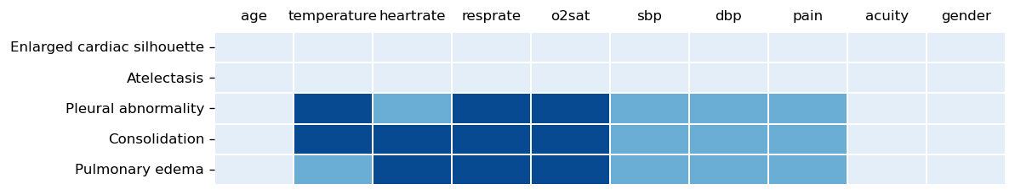
Why did we do this?
According to the interview with radiologists, we found them disagree with the current ML approach. They stated that only providing CXR images is not sufficient to make a reasonable diagnosis. The clinical data, such as body temperature, age, and respiratory rate, are important for them to write the diagnosis report in practice.

Slide 4
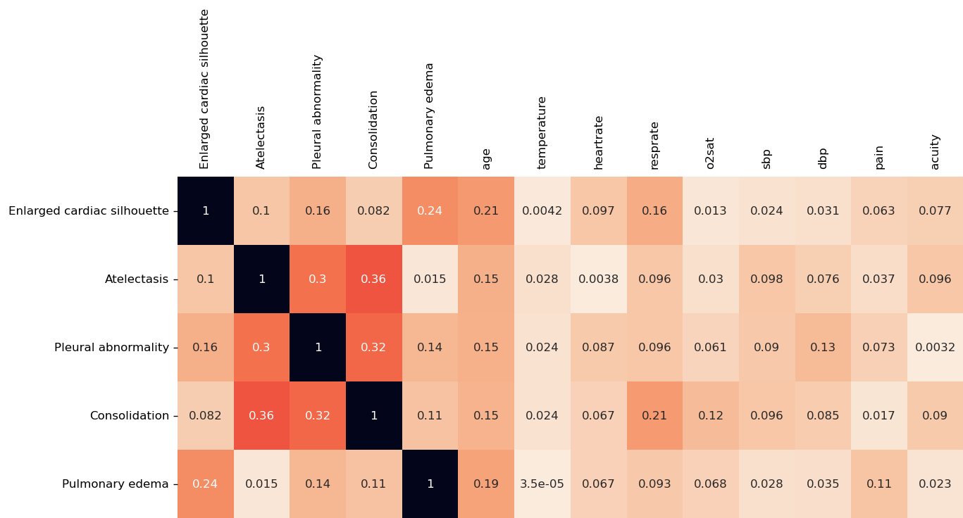
Correlation Matrix between clinical data and abnormalities

Slide 5
Datasets used in this work
Notes:
1. We first introduce all the datasets about the

Slide 6
1. MIMIC-IV (Medical Information Mart for Intensive Care)
Is an update to MIMIC-III, which contains critical care data for over 40,000 patients from Beth Israel Deaconess Medical Centre.
The clinical data, including gender and age, in the hosp module are used in our work.
Link: https://physionet.org/content/mimiciv/2.0/

Slide 7
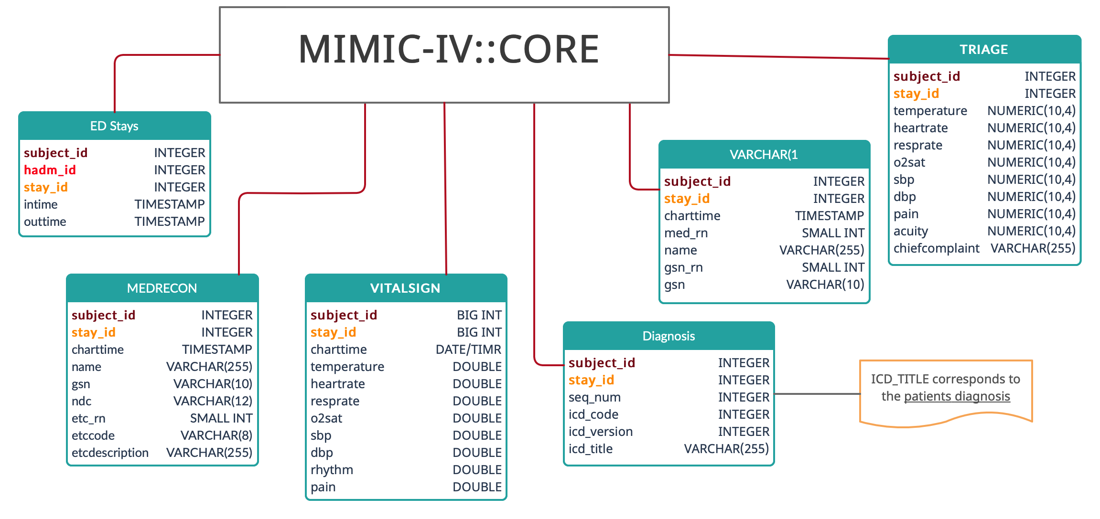
2. MIMIC-IV ED
MIMIC-ED is a subset of MIMIC-IV, collected from emergency department (ED) admissions at the Beth Israel Deaconess Medical Center between 2011 and 2016. As of MIMIC-ED v1.0, the database contains 448,972 ED stays. Vital signs, triage information, medication reconciliation, medication administration, and discharge diagnoses are available.

Slide 8
3. MIMIC-CXR (~6TB)
is a large publicly available dataset of
chest radiographs in DICOM format;
free-text radiology reports.
is a subset of MIMIC-IV ED containing 377,110 images corresponding to 227,835 radiographic studies performed at the Beth Israel Deaconess Medical Center in Boston, MA
Link: https://physionet.org/content/mimic-cxr/2.0.0/

Slide 9
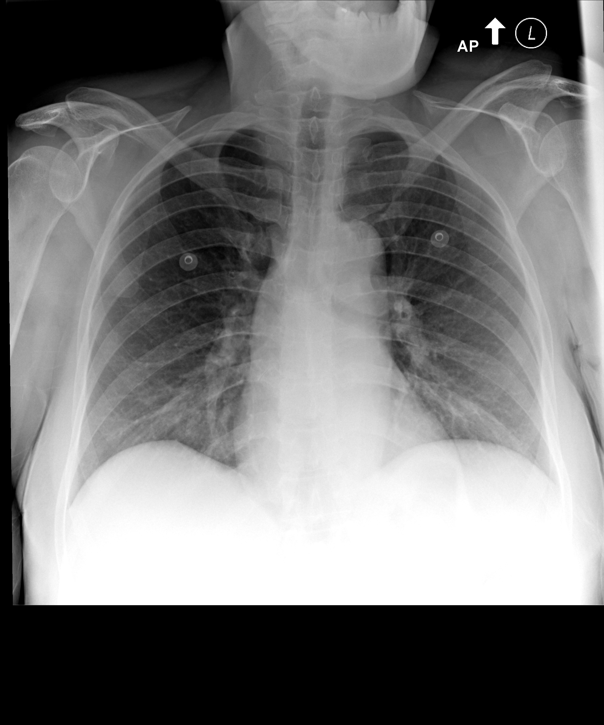
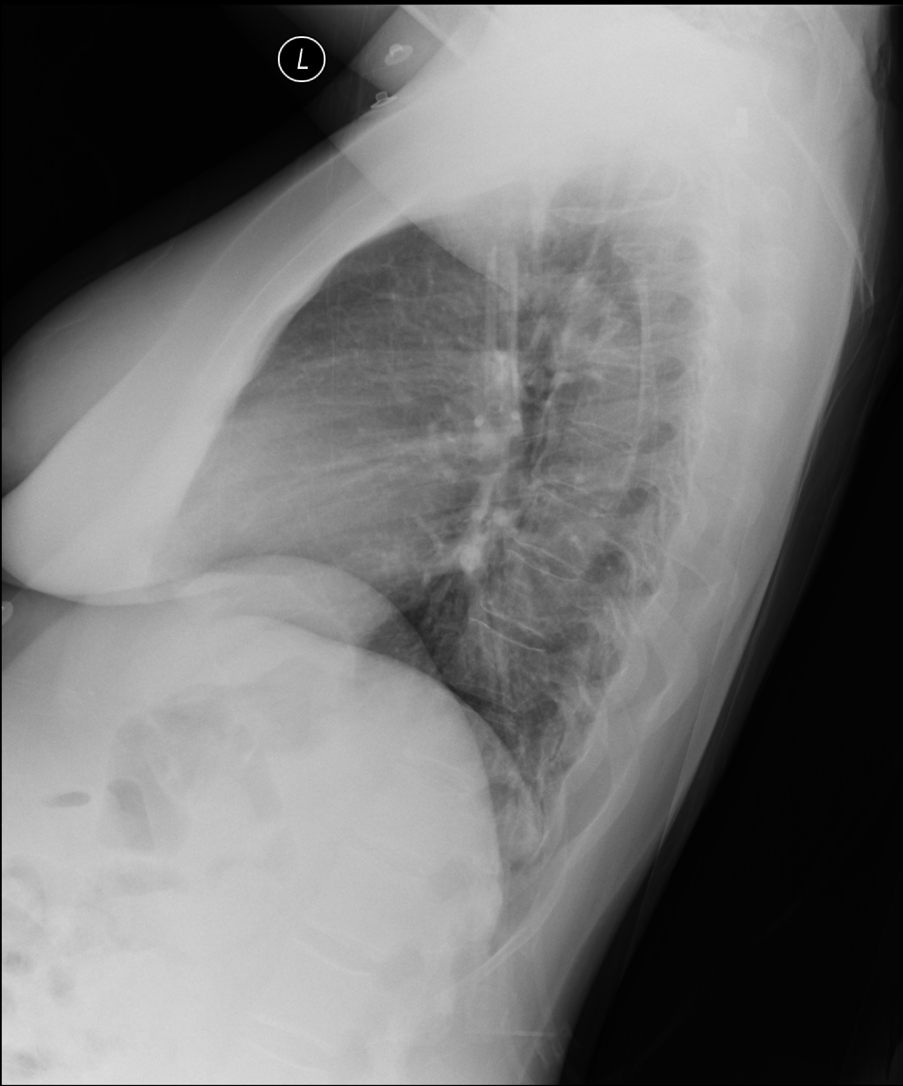
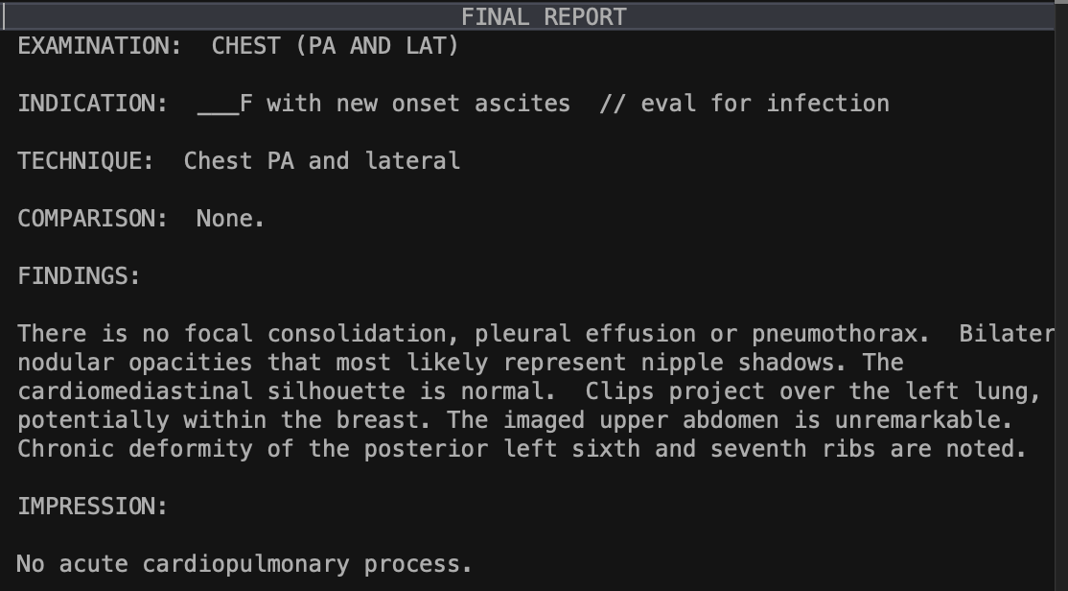
MIMIC-CXR
Posteroanterior view
Lateral view
Report
DIAGNOSIS: NORMAL

Slide 10
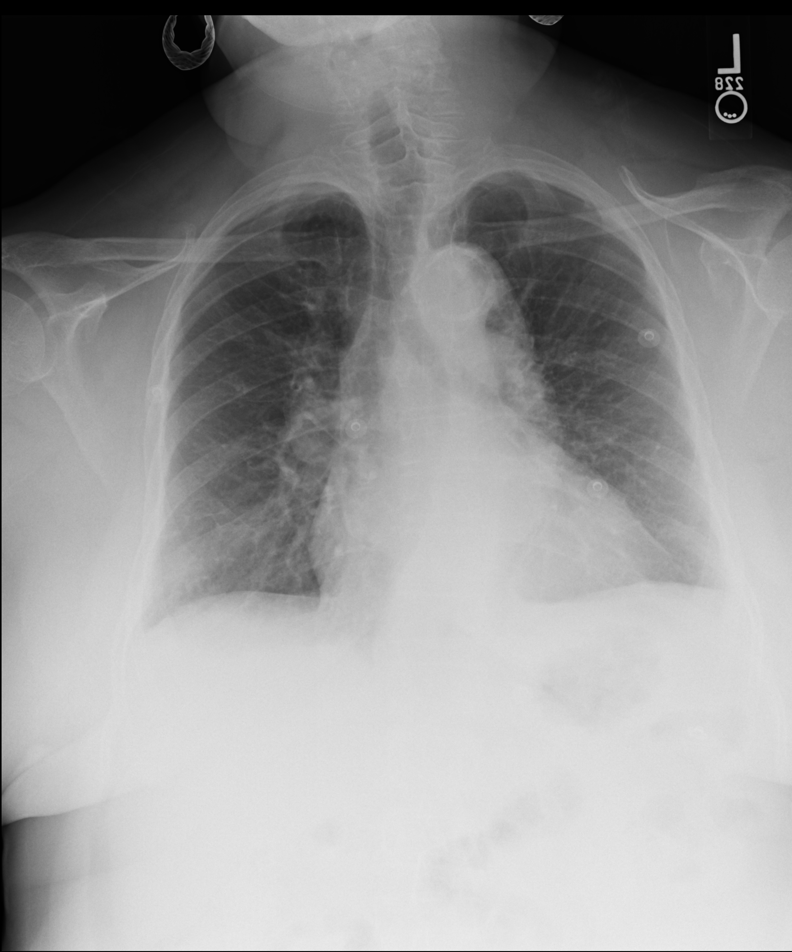
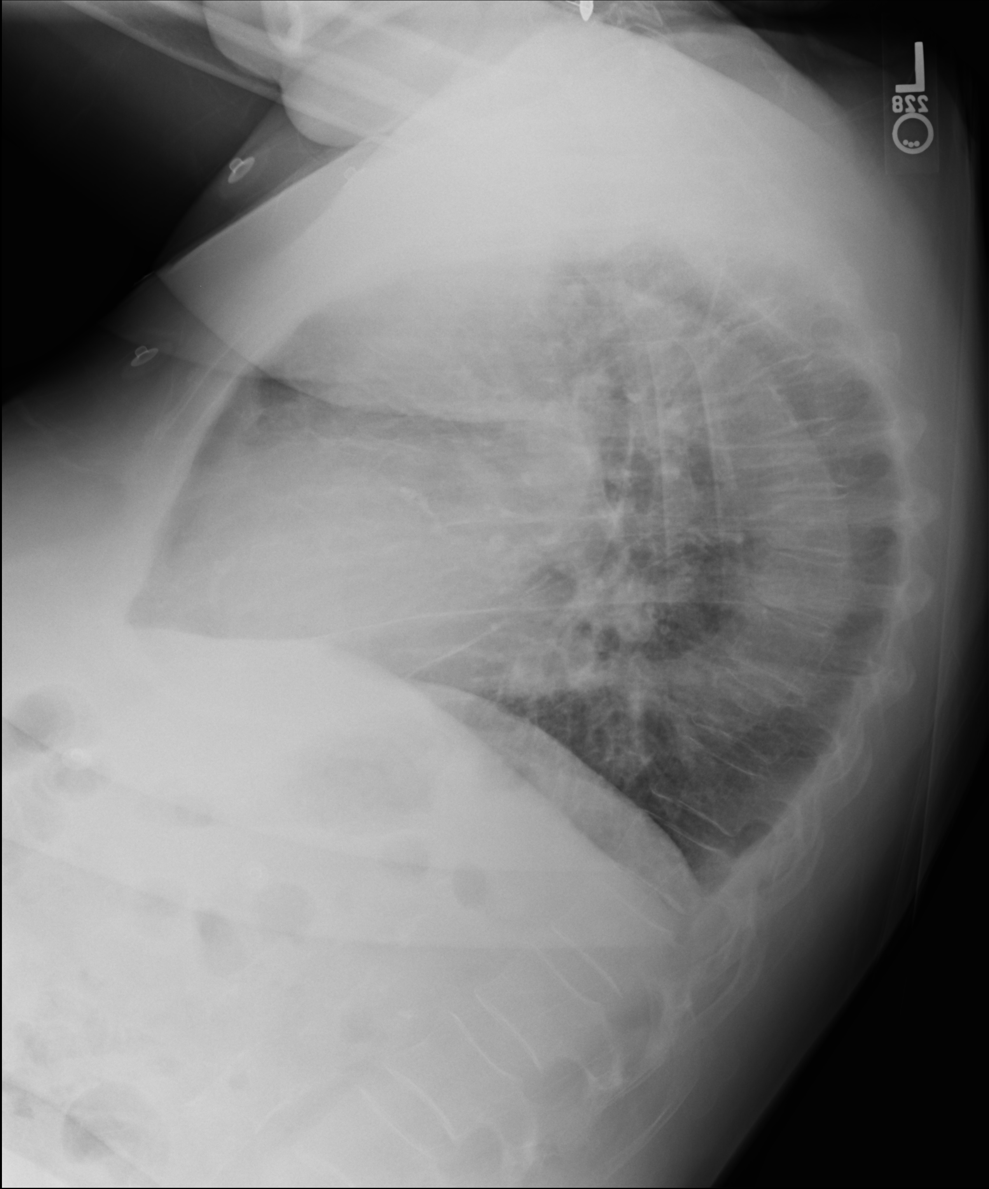
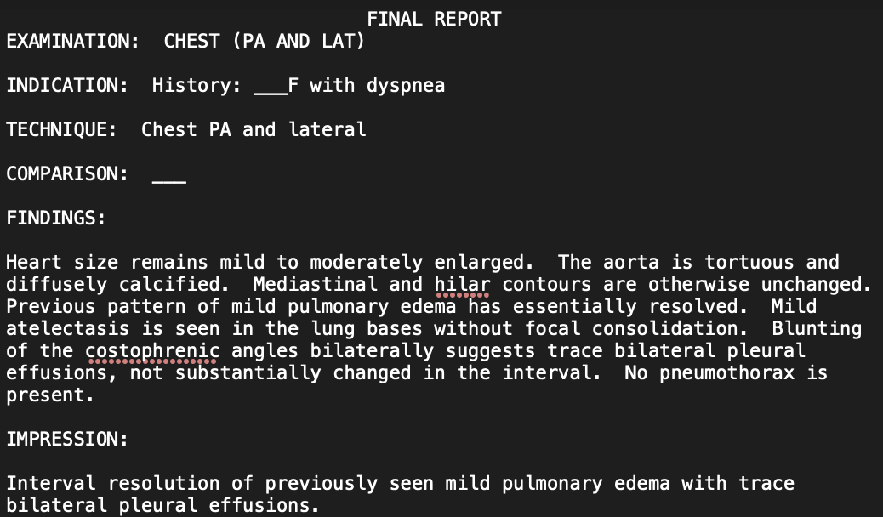
MIMIC-CXR
Posteroanterior view
Lateral view
Report
DIAGNOSIS: MILD PULMONARY EDEMA

Slide 11
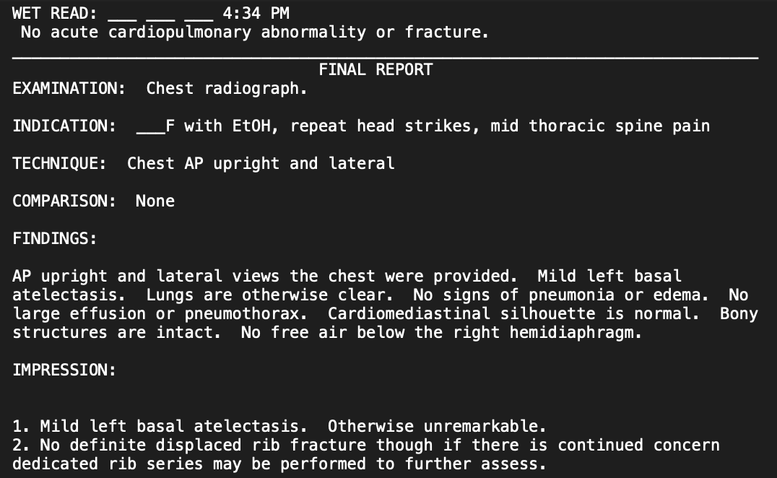
MIMIC-CXR
Posteroanterior view
Lateral view
Report
DIAGNOSIS: BASAL ATELECTASIS

Slide 12
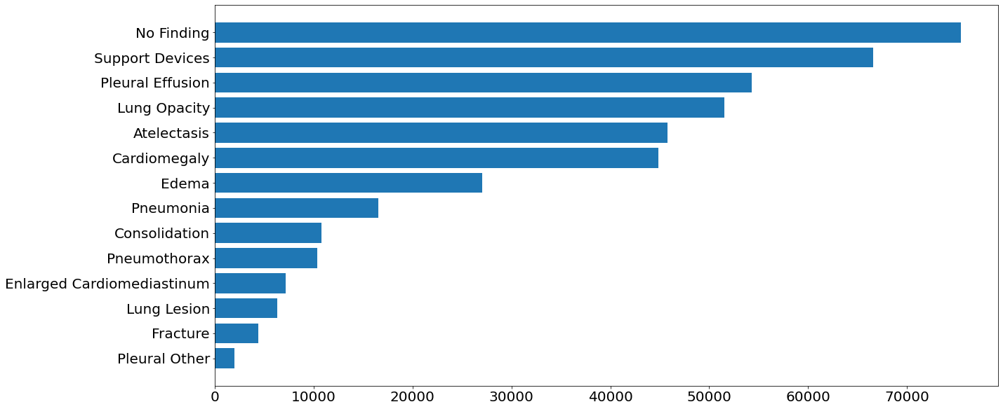
Abnormality distribution (Chexpert)

Slide 13
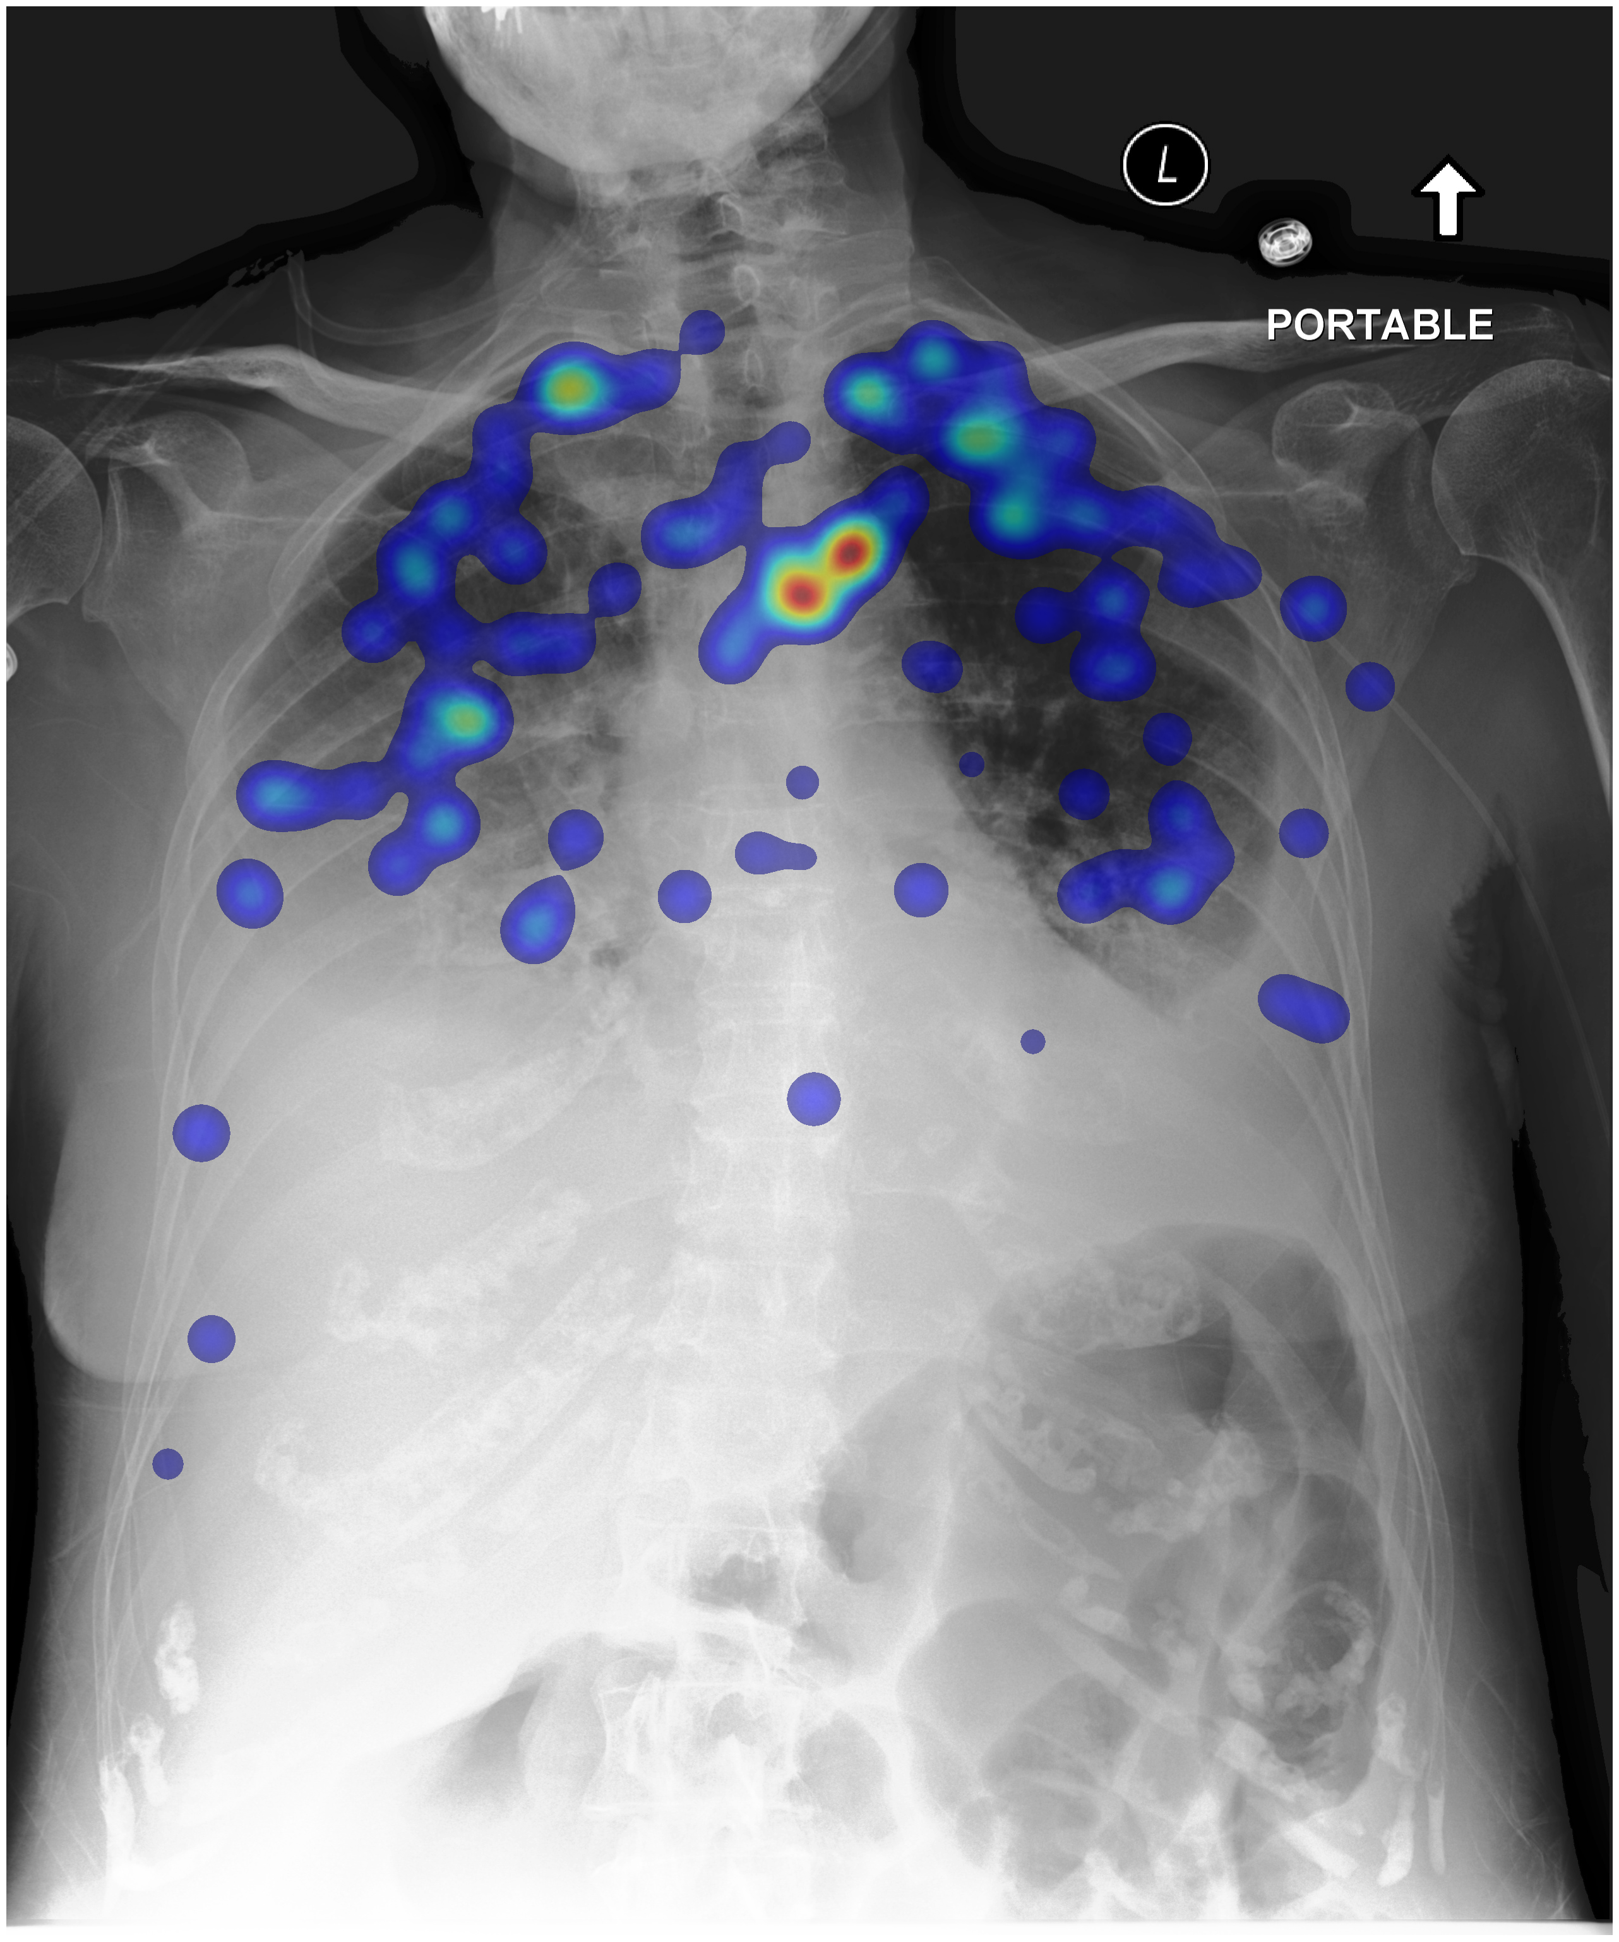
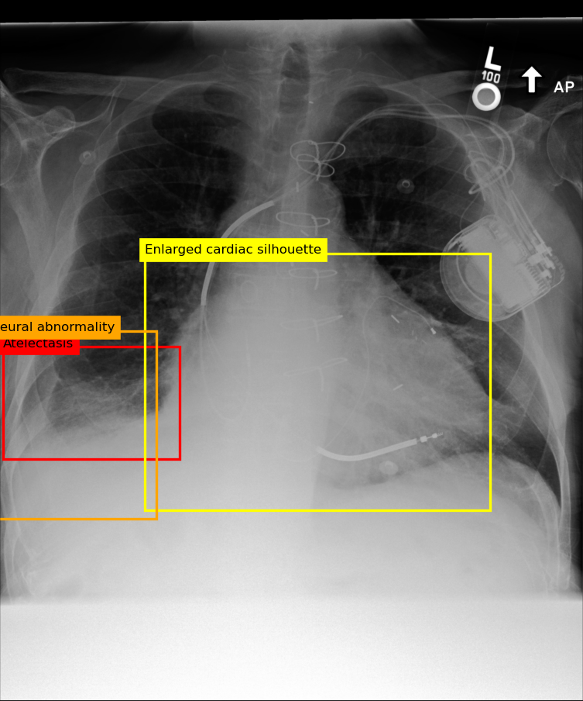
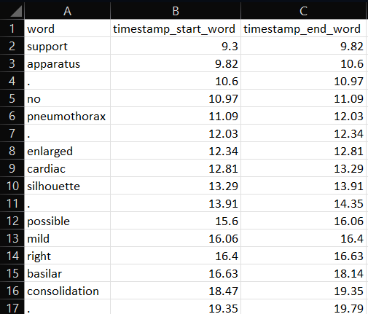
4. REFLACX
A subset of MIMIC-CXR containing 3,052 studies.
Time-stamped utterance
Eye tracking data from radiologists
Bounding boxes (ellipses)

Slide 14
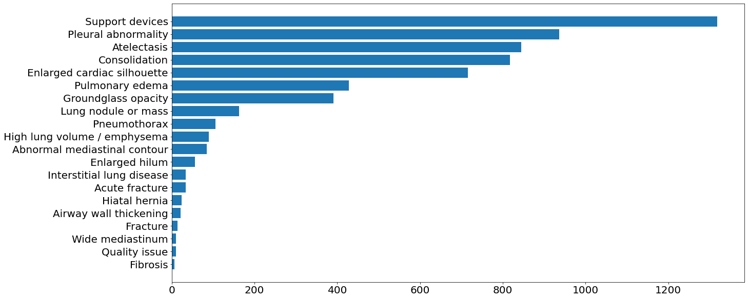
Abnormality distribution

Slide 15
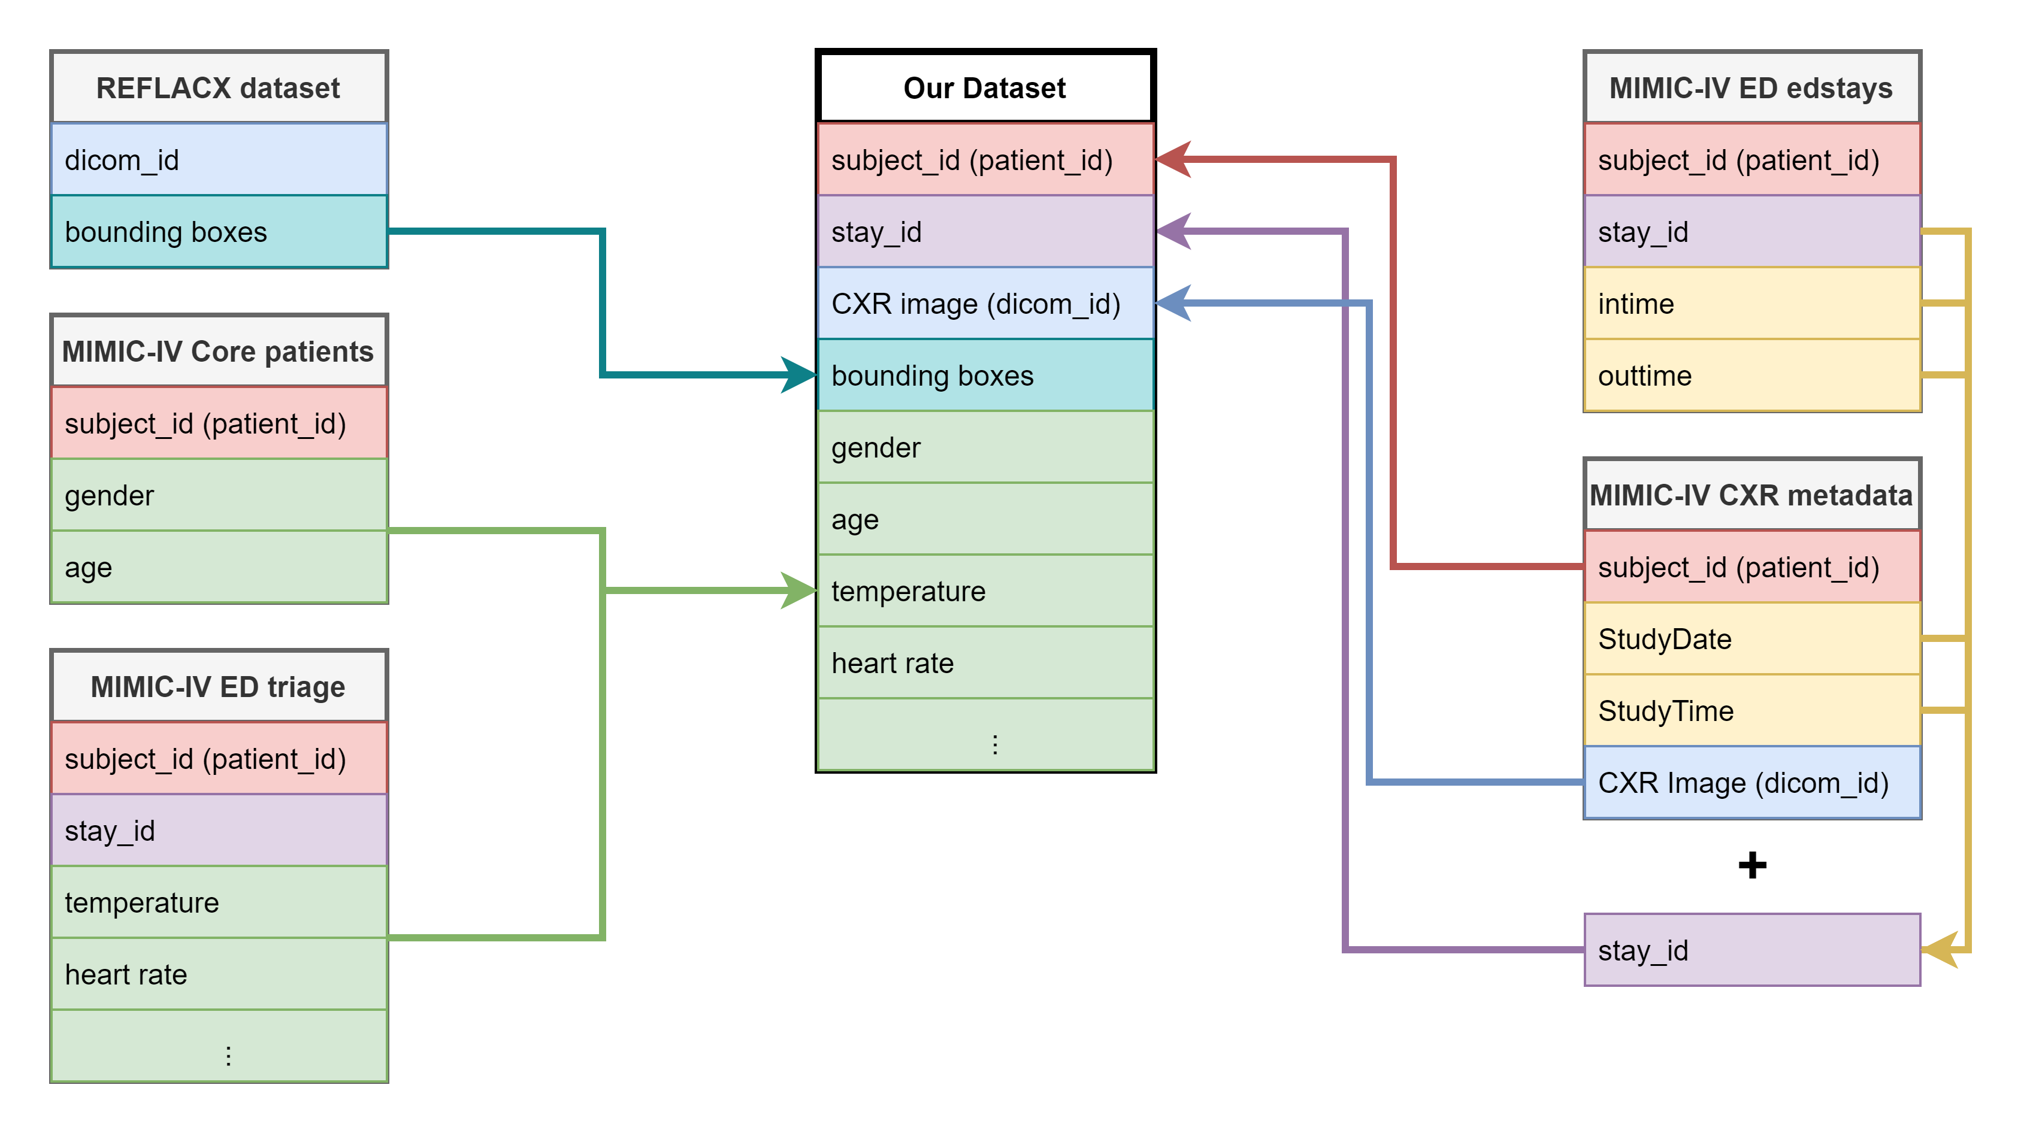
Our multimodal dataset

Slide 16
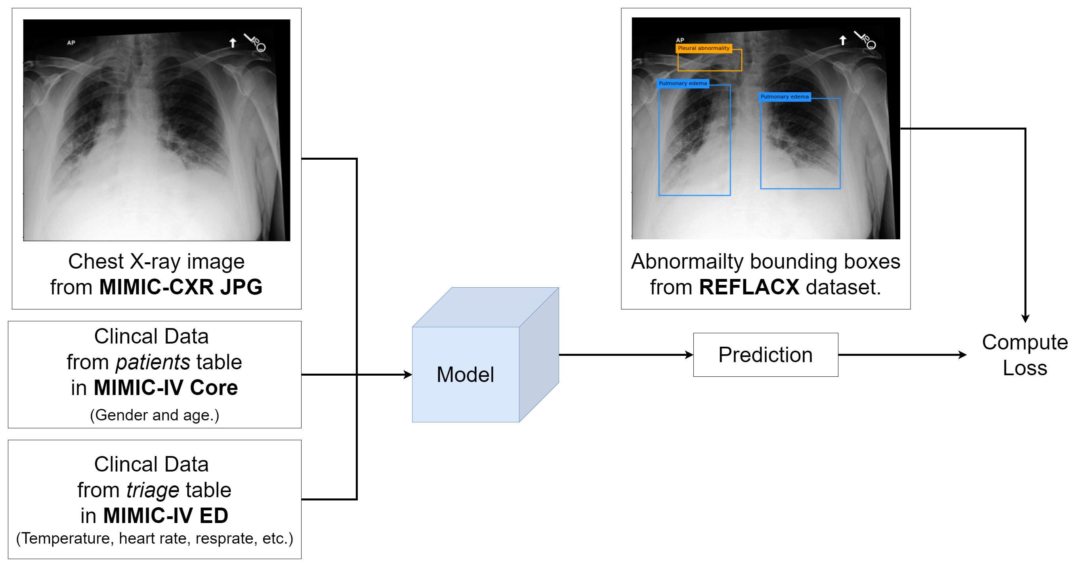
Abnormality Detection

Slide 17
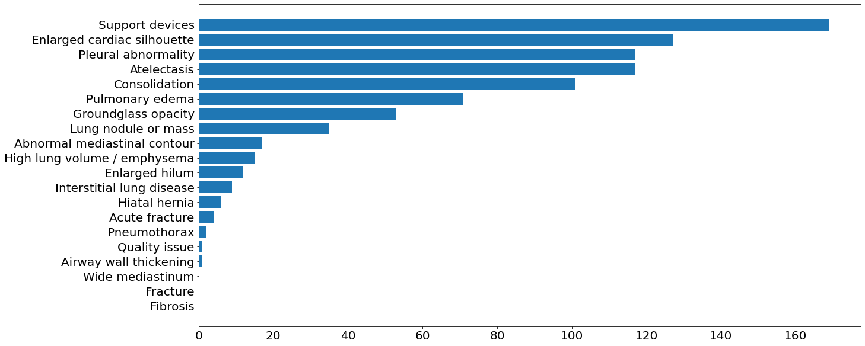
Abnormality Distribution in our dataset

Slide 18
Architecture of MDF-Net Adapted from baseline (Mask R-CNN) to MDF-Net

Slide 19
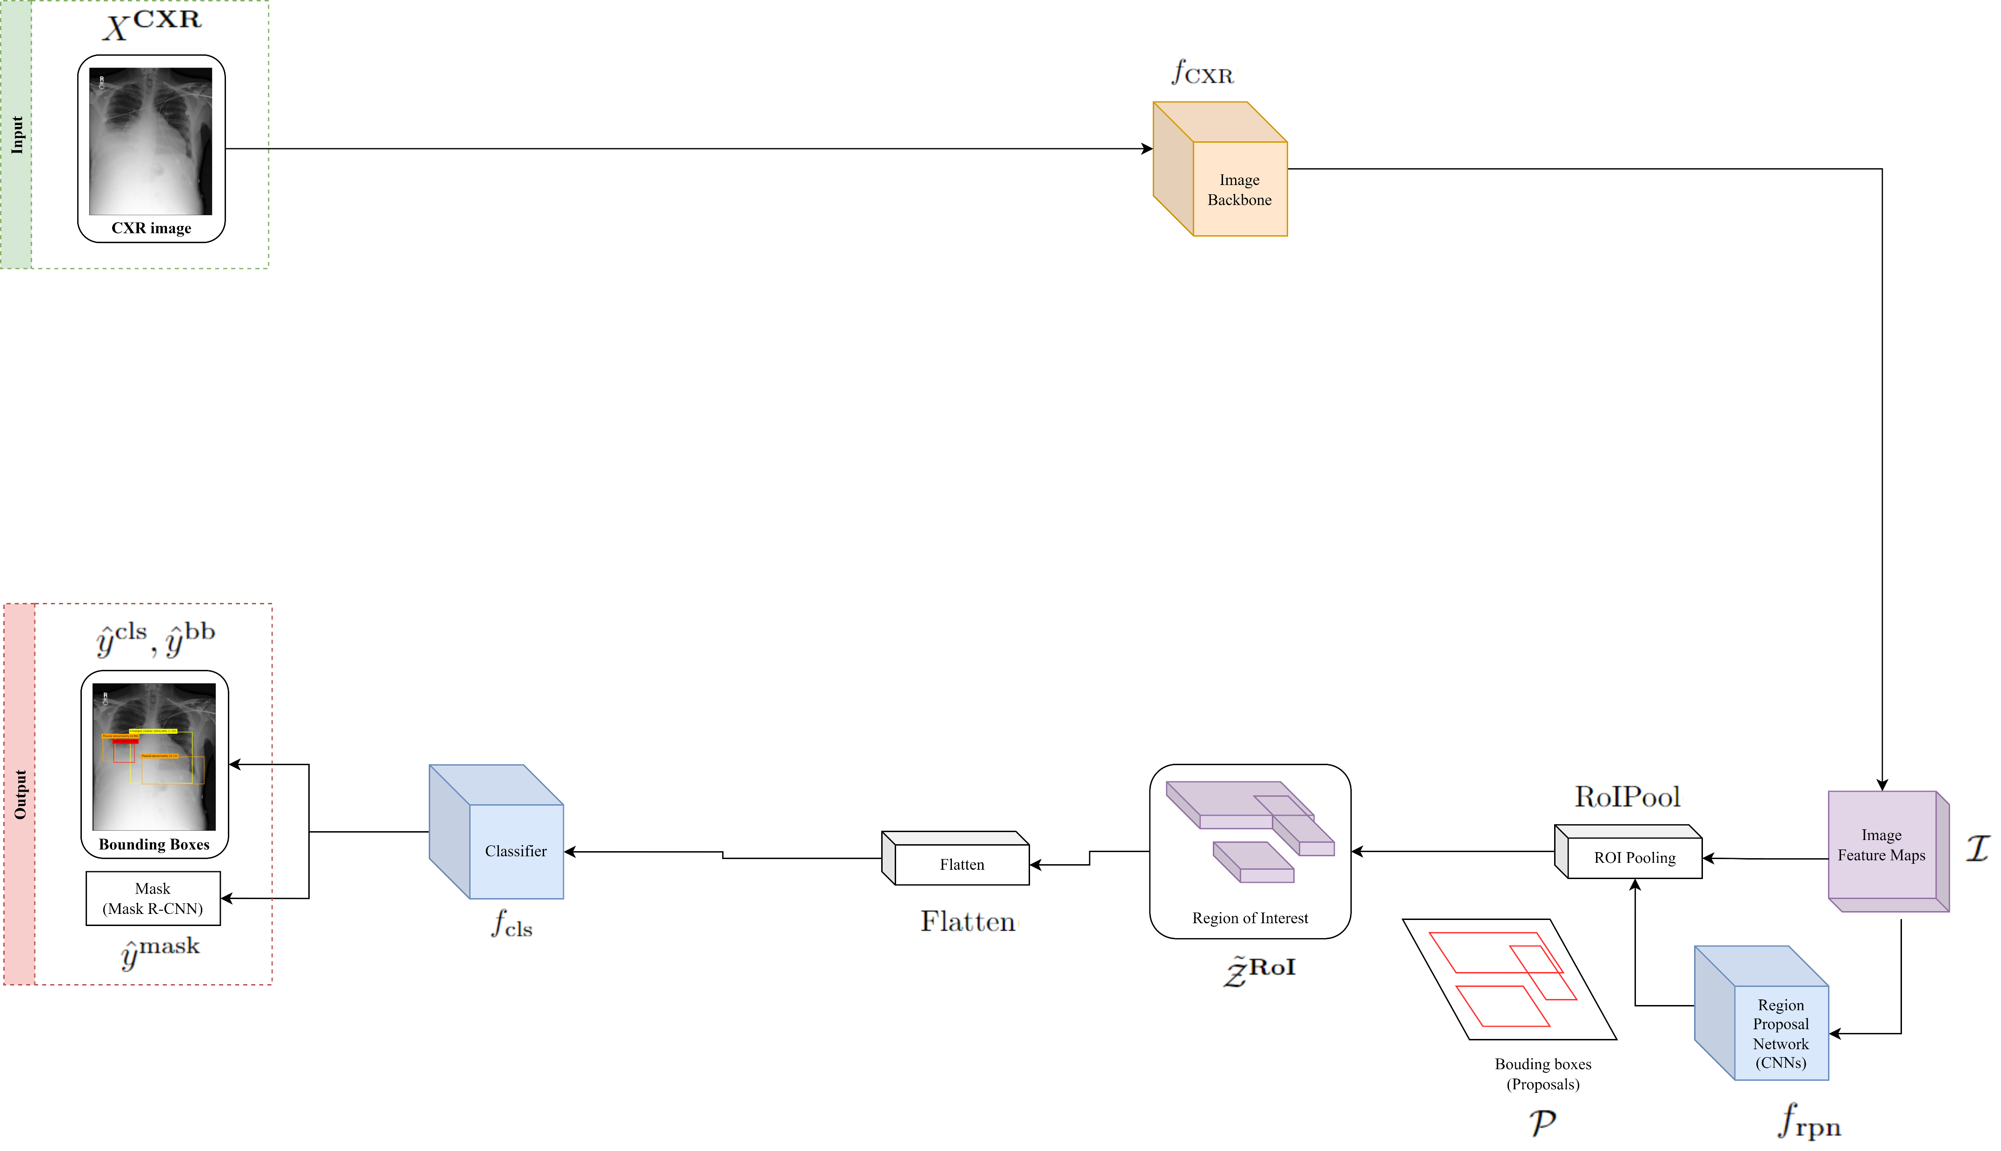
Mask R-CNN

Slide 20
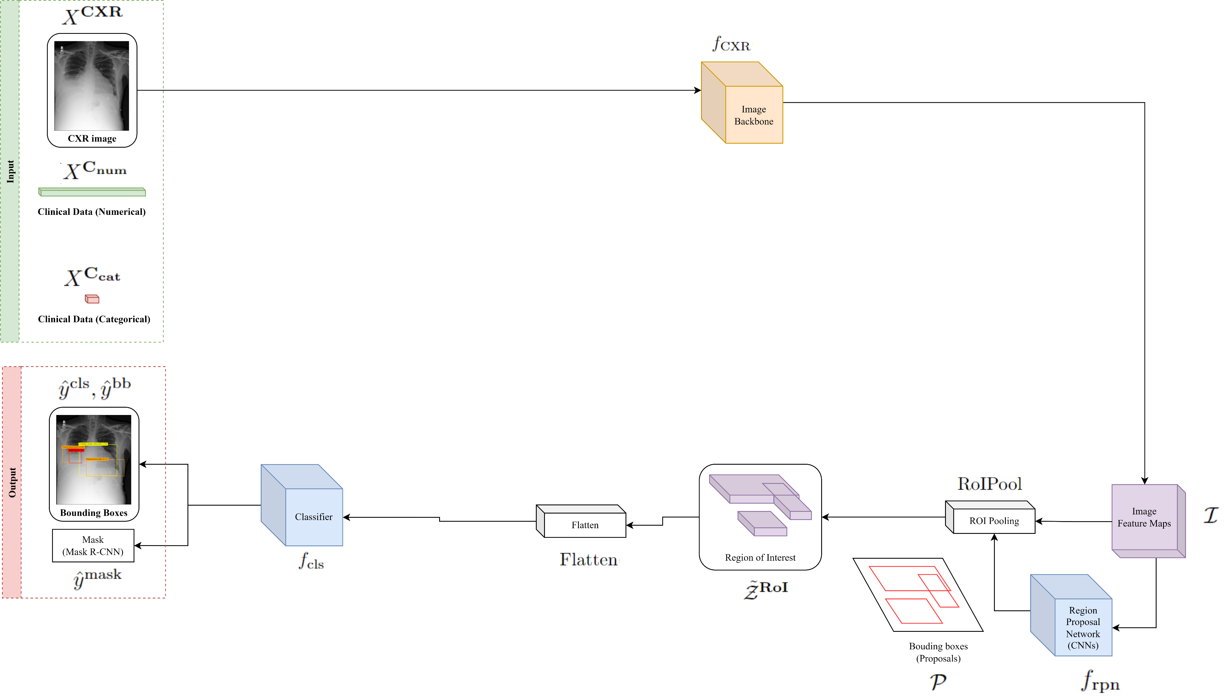
Introduce Clinical data

Slide 21
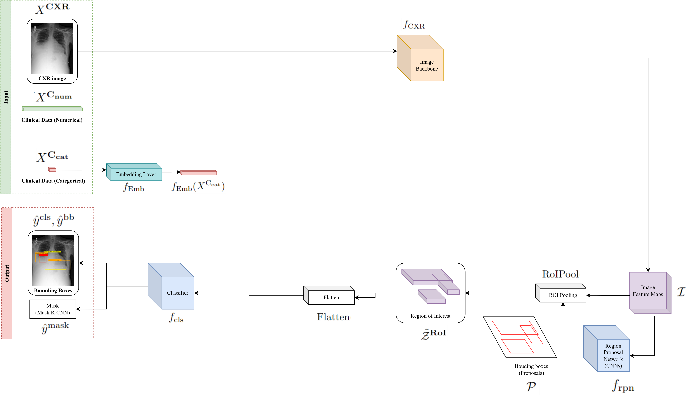
Embedding categorical clinical data

Slide 22
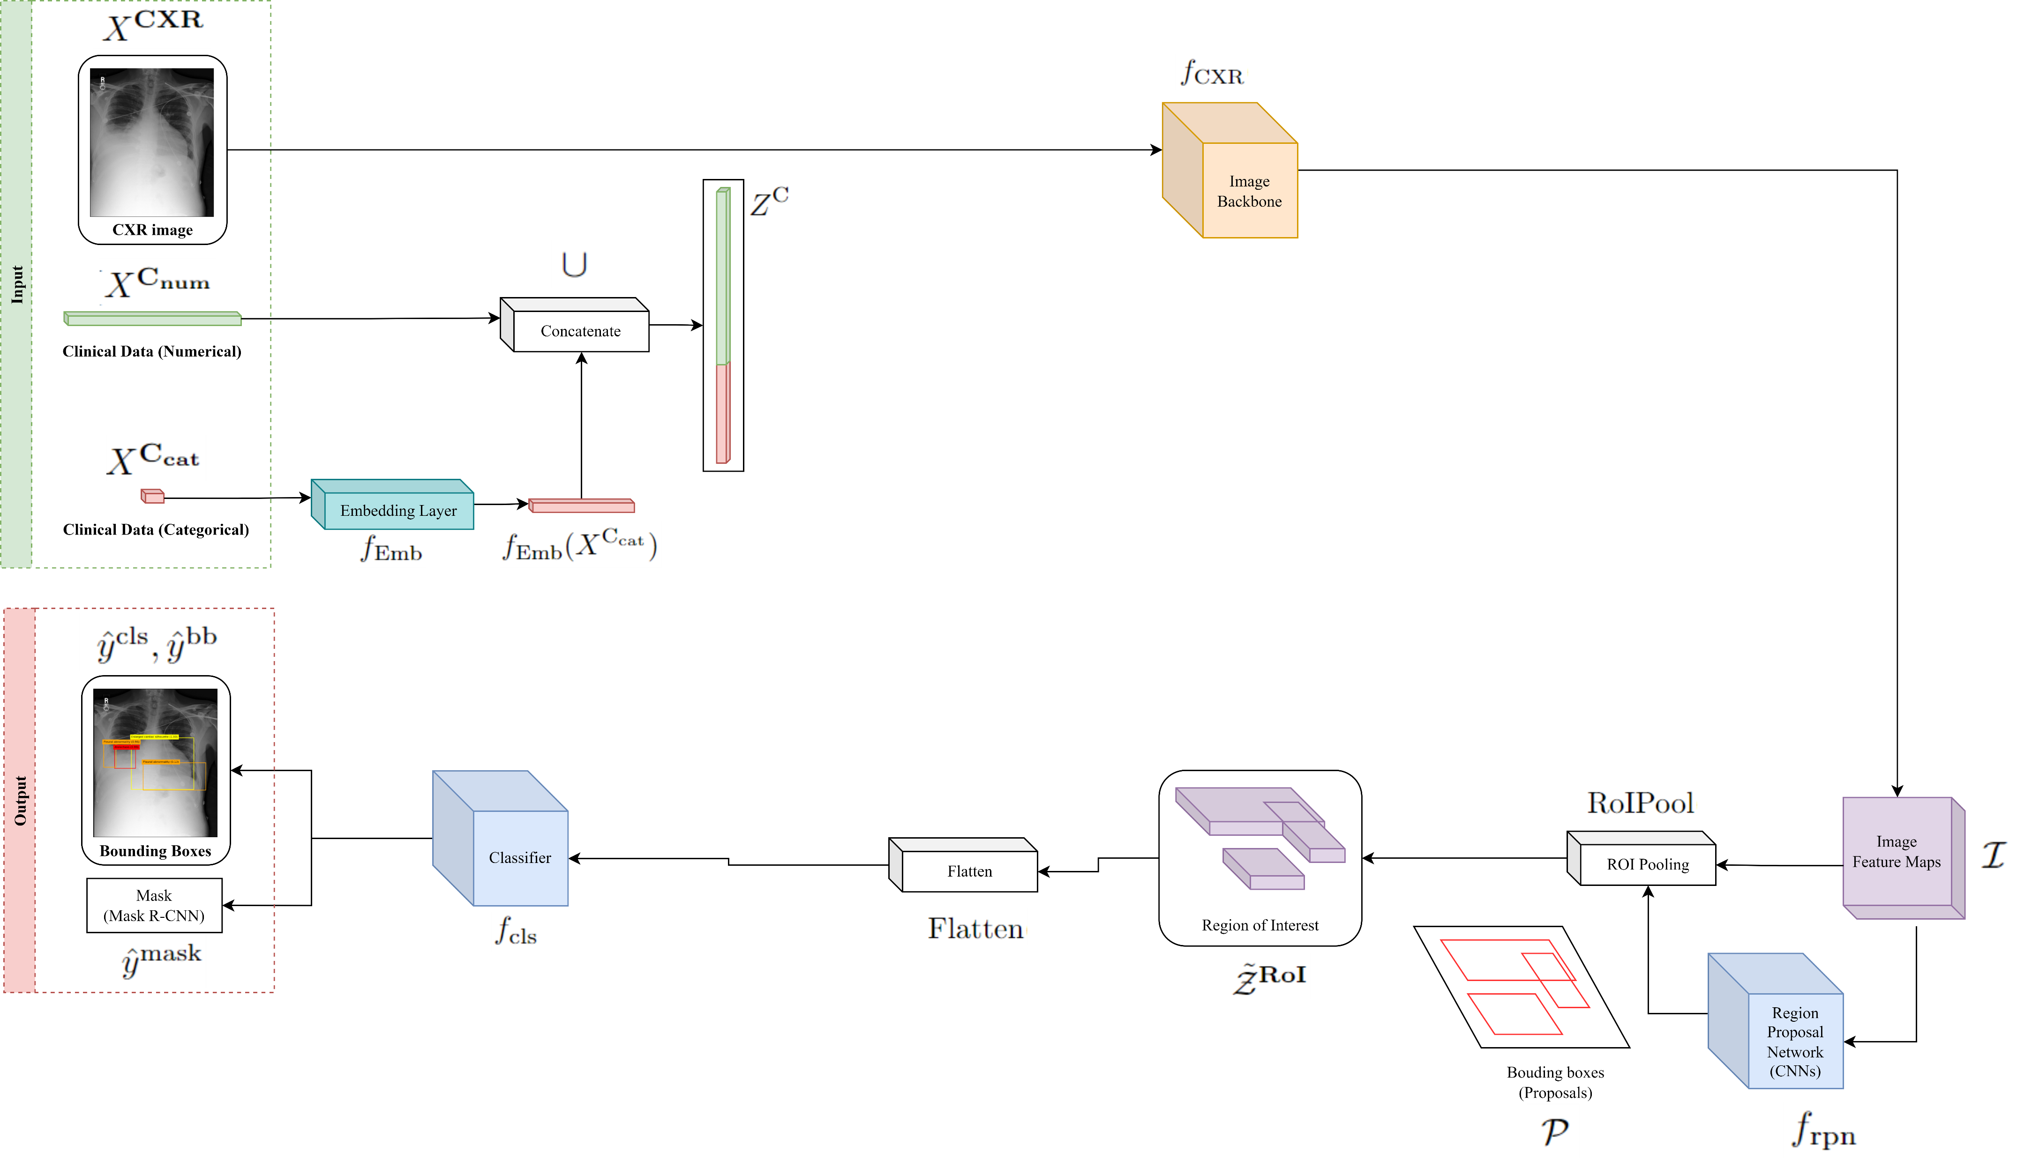
Concatenate both clinical data

Slide 23
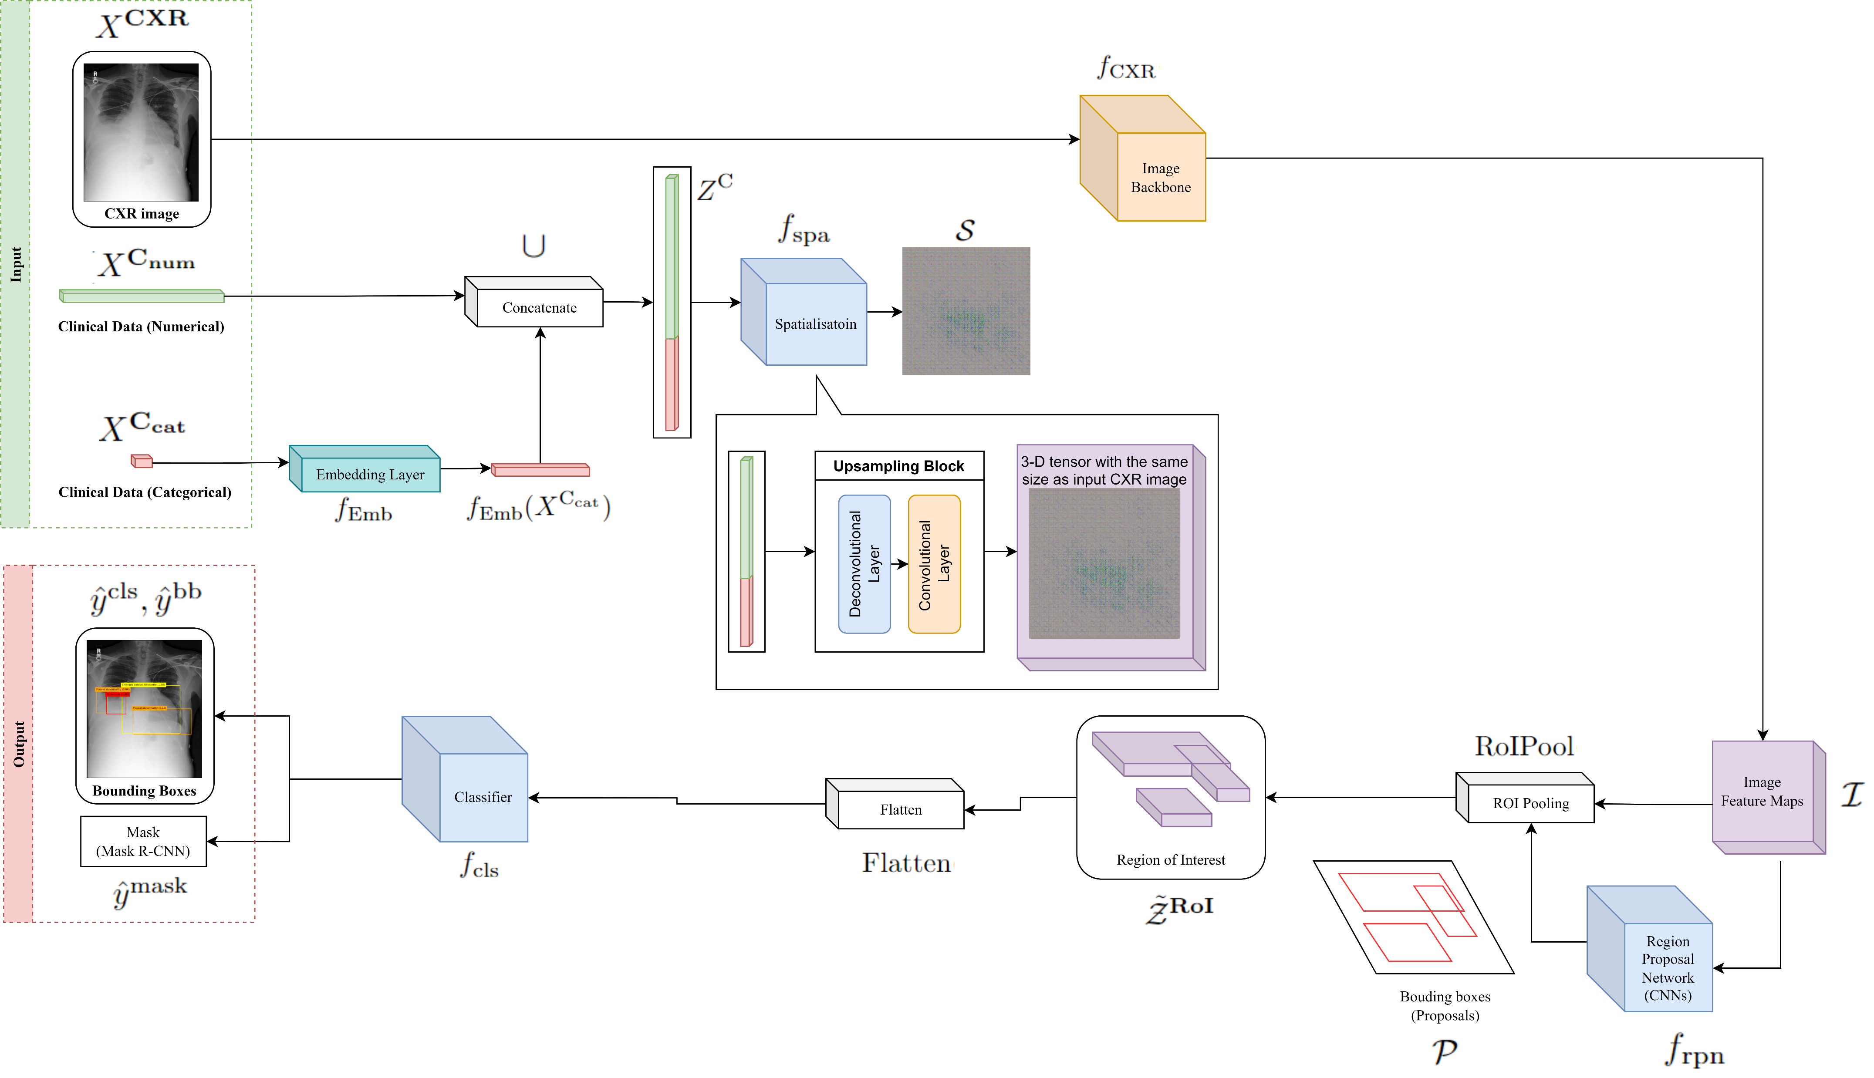
Spatialisation

Slide 24
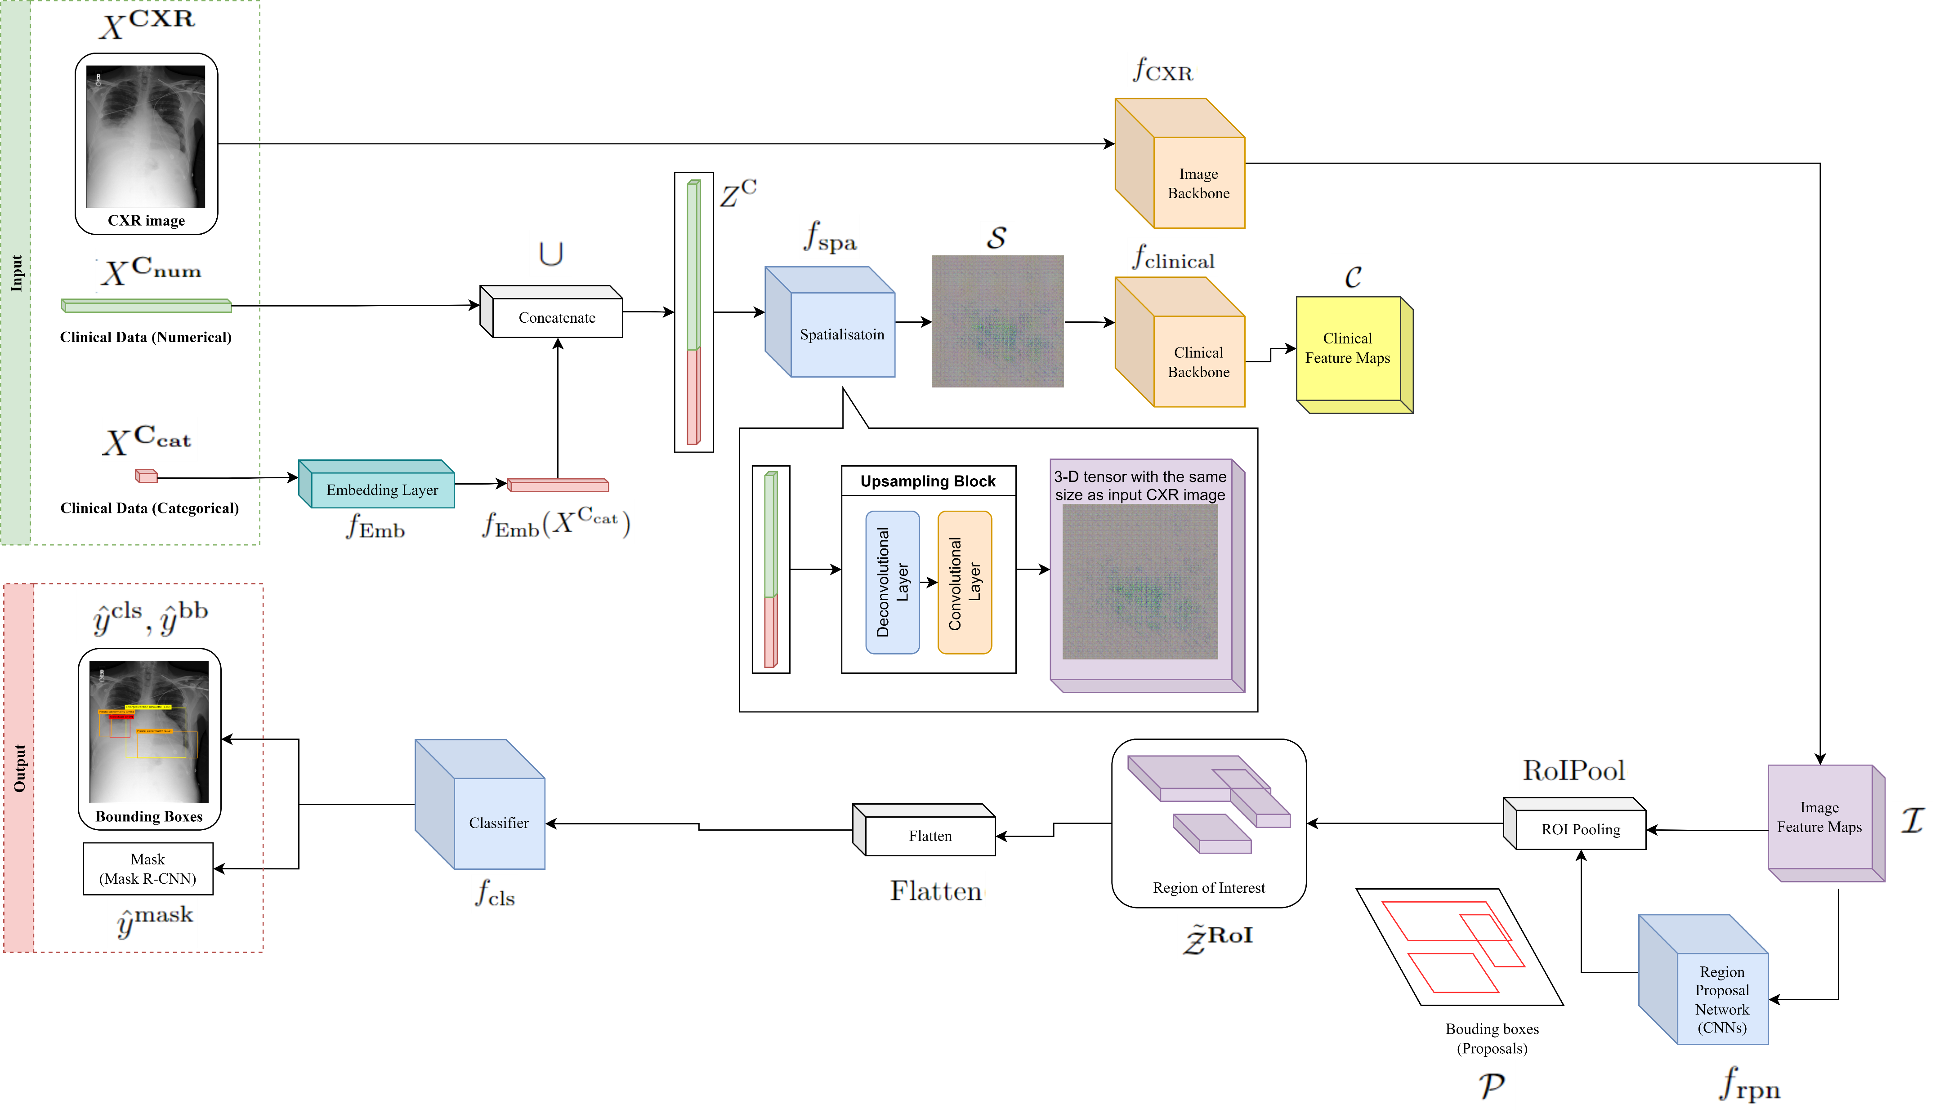
Clinical feature maps

Slide 25
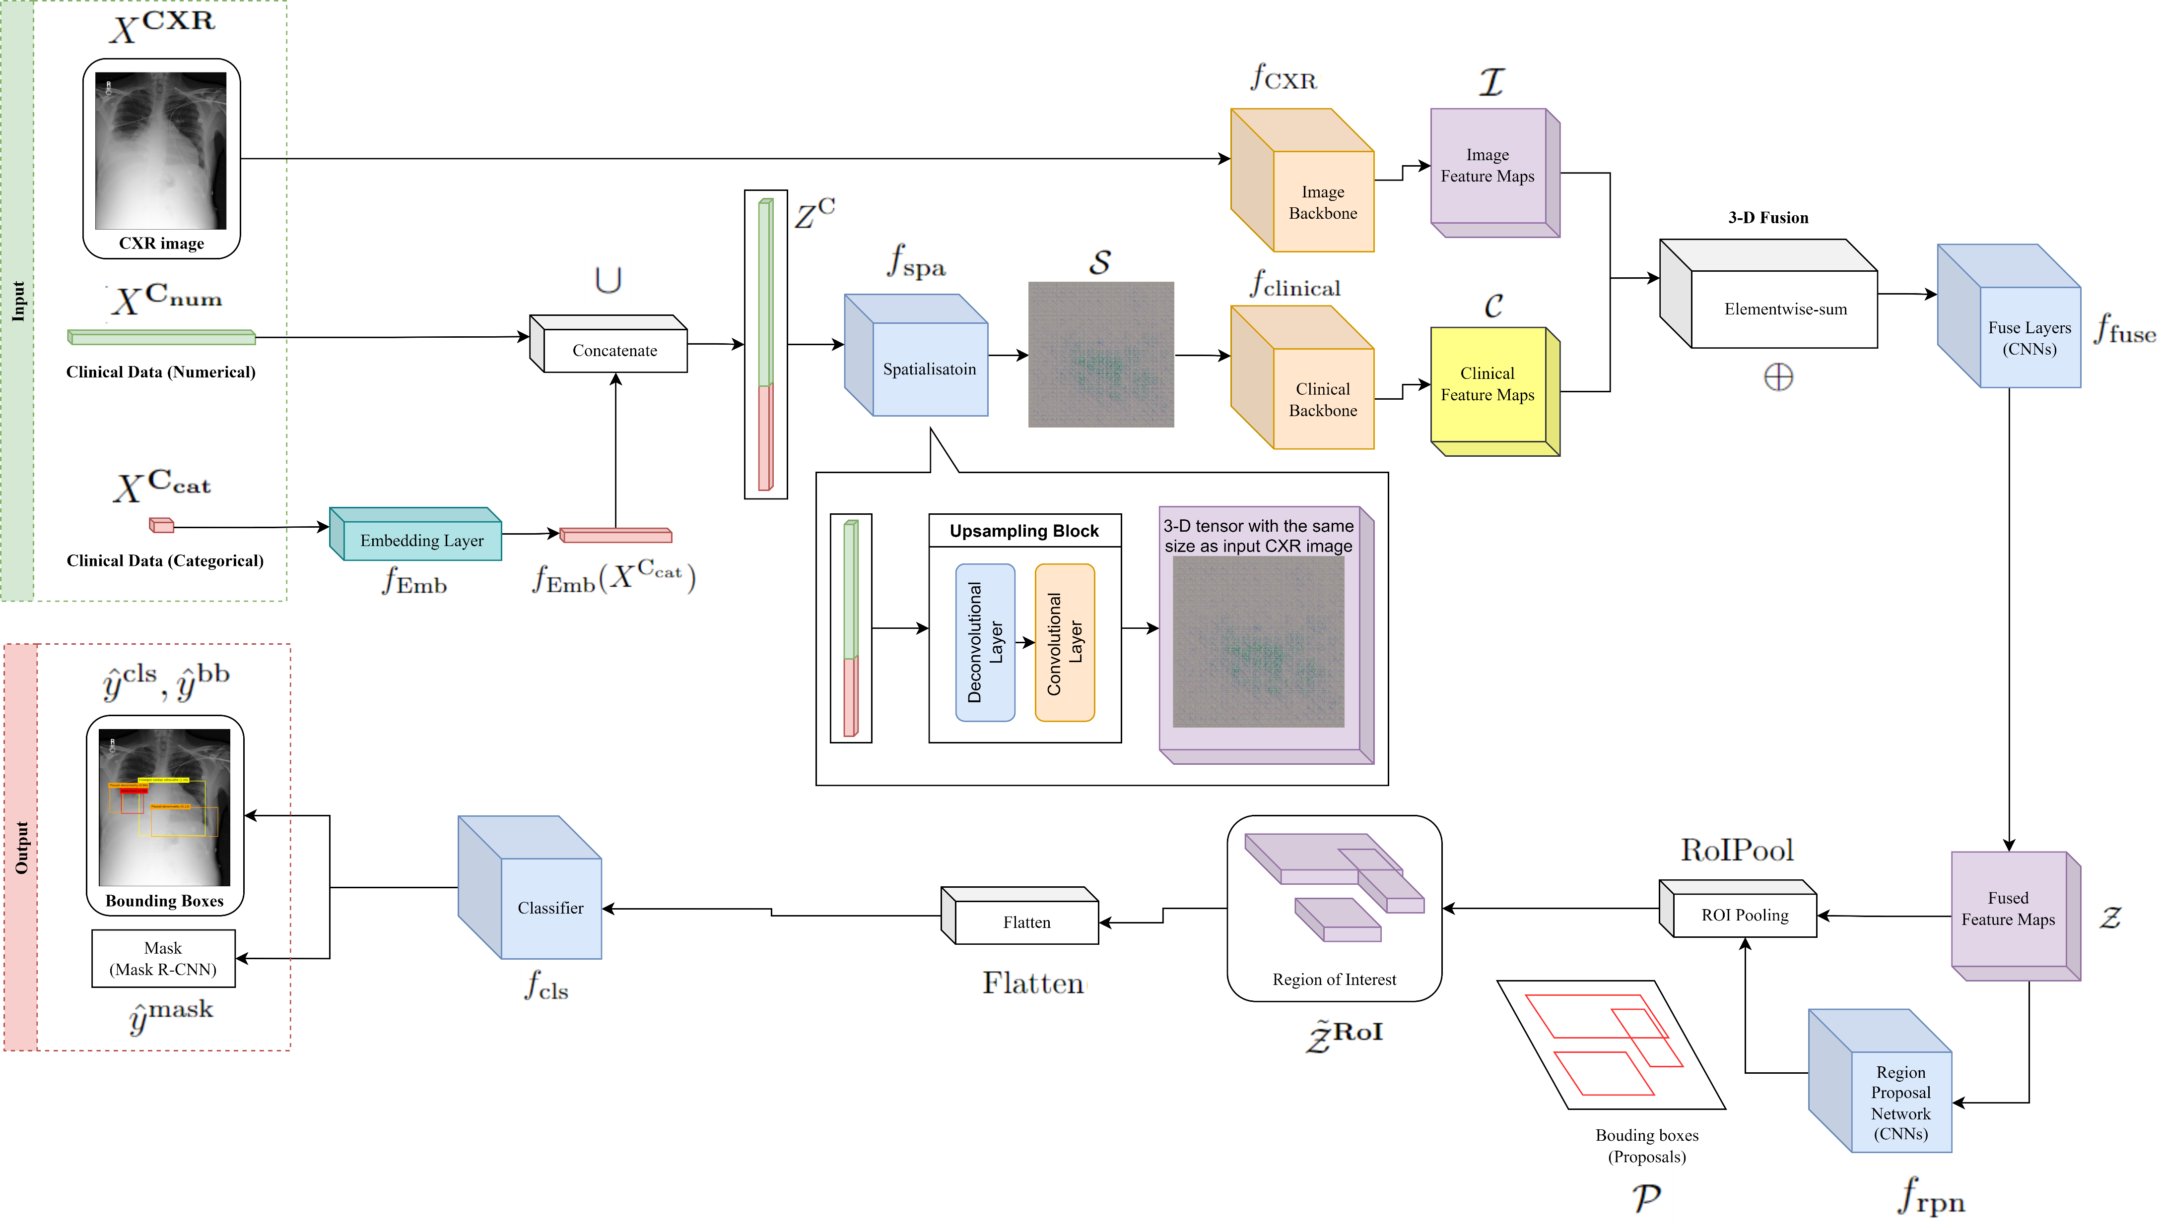
3-D Fusion

Slide 26
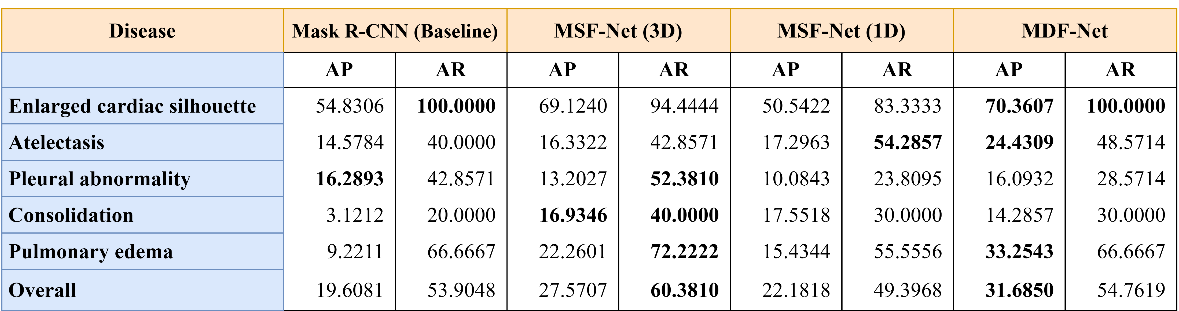
Results

Slide 27
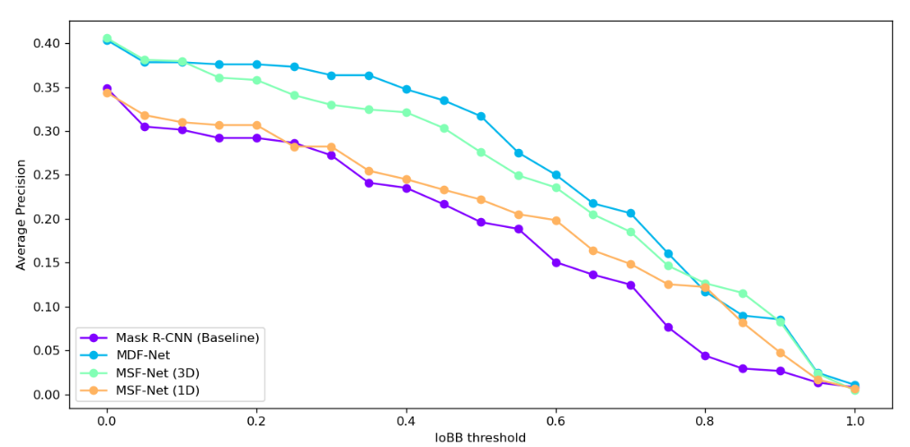
Average precision among IoBB thresholds

Slide 28
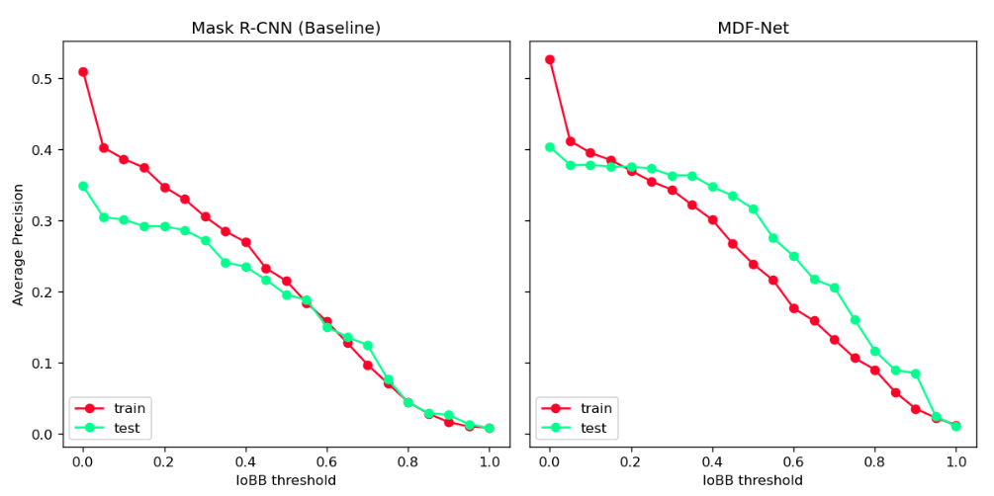
Generalization Performance

Slide 29
Challenges encountered in this work

Slide 30
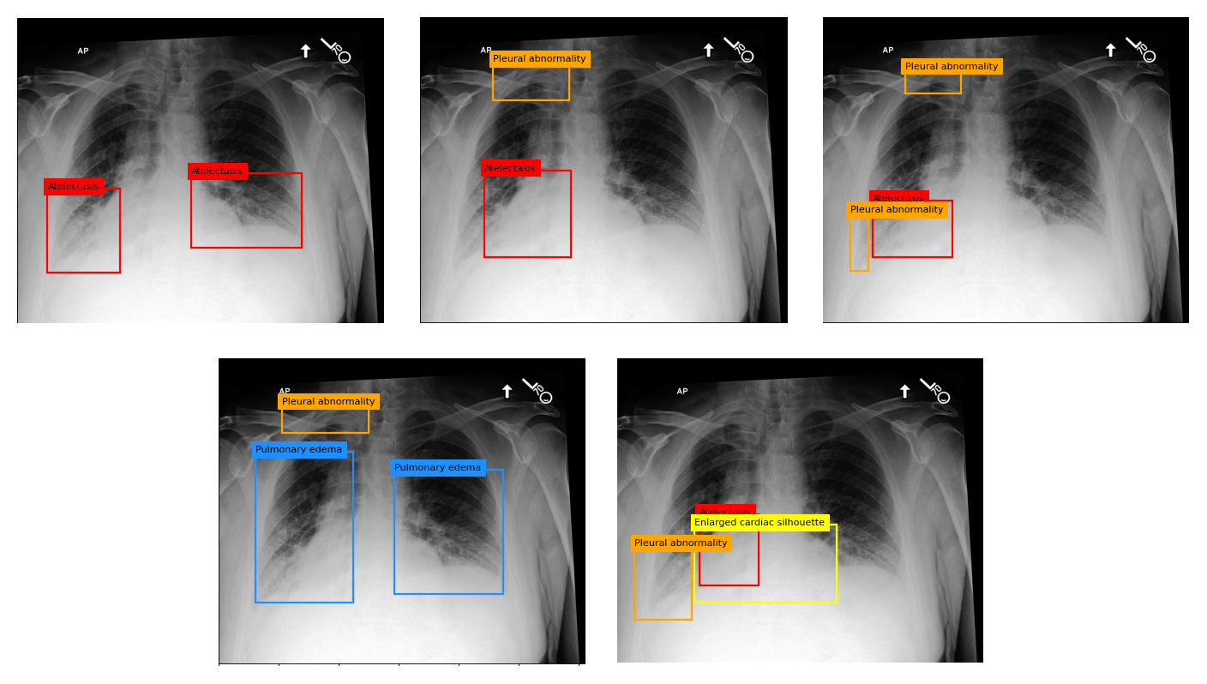
Radiologists have a different standard for annotating abnormalities.

Slide 31
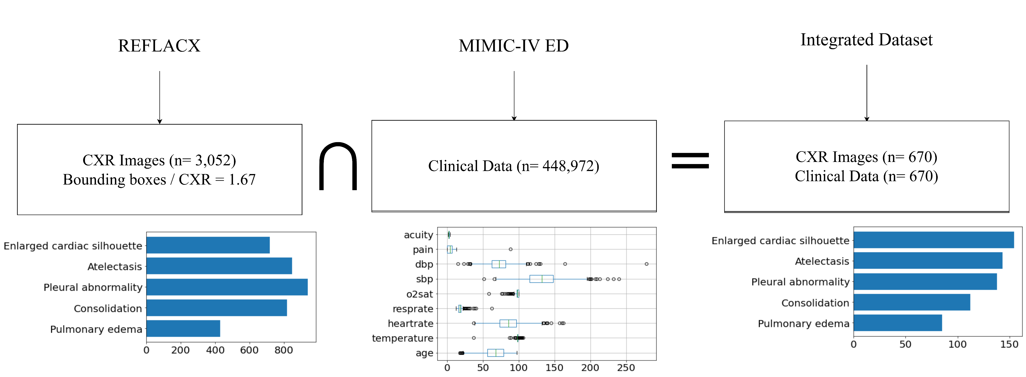
Version conflict between datasets
Need to wait for MIMIC-CXR to update their patient_id.

